Slide 1
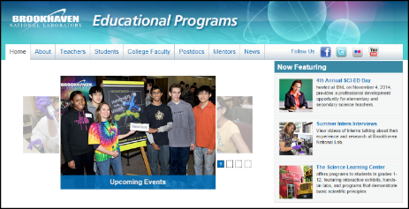
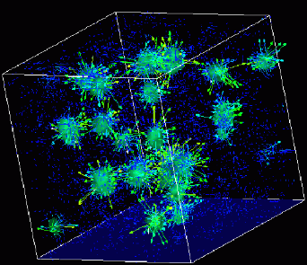
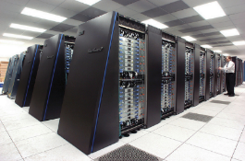
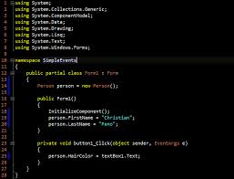
Advanced
Scientific Computing
(SciComp 201)
Session 16
Allegro Graphics,
Euler Line

Slide 2
Session Goals
Learn the SimpleScreen custom class to draw graphics
Understand the World bounding rectangle
Use Cartesian coordinates to draw 2D lines
Draw lines, polygons, and filled polygons
Calculate and draw the coordinates of the Euler line for a random triangle

Slide 3
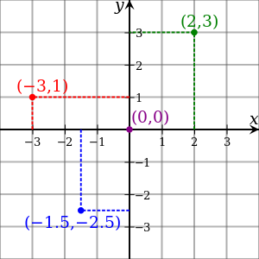
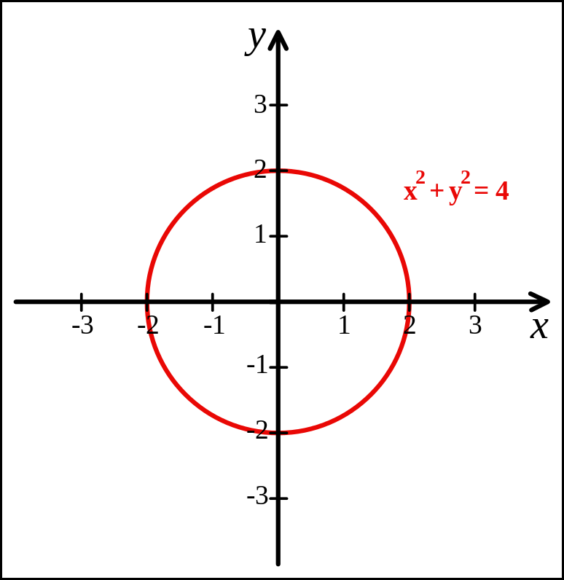
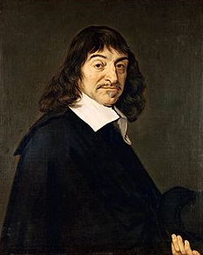
Cartesian Coordinates
Created by René Descartes in 1637

Slide 4
Screen Pixels
A computer screen is divided into 2D array of small rectangles called pixels
Every pixels has both an X and a Y coordinate
Each pixel is set to a specific color
The number of pixels in each dimension is the resolution
Modern screens have resolutions greater than 1920 x 1080
The top left screen pixel has coordinates (0,0)
Sadly there is a major discrepancy between Cartesian coordinates and pixel coordinates!

Slide 5
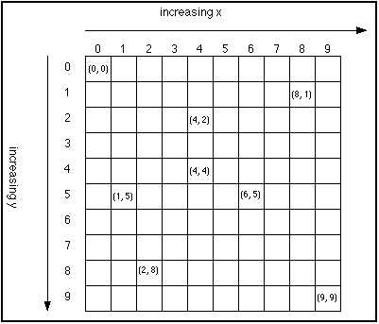
Screen Y vs. World Y Coordinates
In screen coordinates, as you move from the top of the screen towards the bottom, the Y coordinate increases!
This is the exact opposite of world (Cartesian) coordinates
Fortunately, the X axis behaves the as expected between the screen and world coordinate system
This discrepancy will drive you nuts!

Slide 6
World Bounding Rectangle
World coordinates are what we use when doing pure math
Screen coordinates are what we have to use when drawing
We need a way to map World X,Y to Screen X,Y
The world is framed by a “bounding rectangle” which is comprised of four variables of type double
worldXmin, worldYmin
worldXmax, worldYmax
The values for all four World variables are our choice – they can be as big or as small as we want them

Slide 7
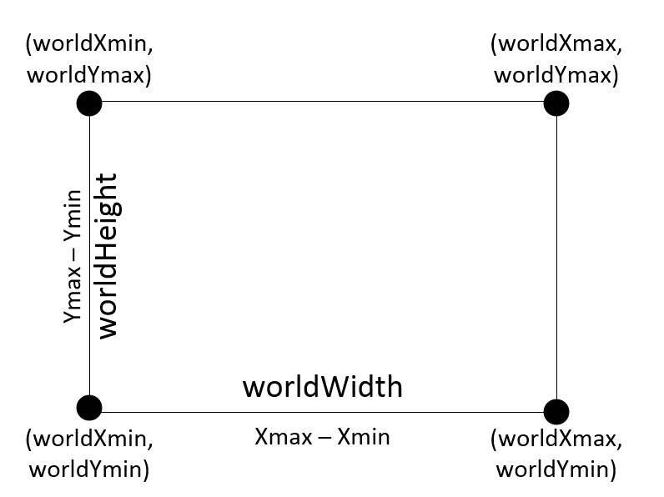

World Bounding Rectangle

Slide 8
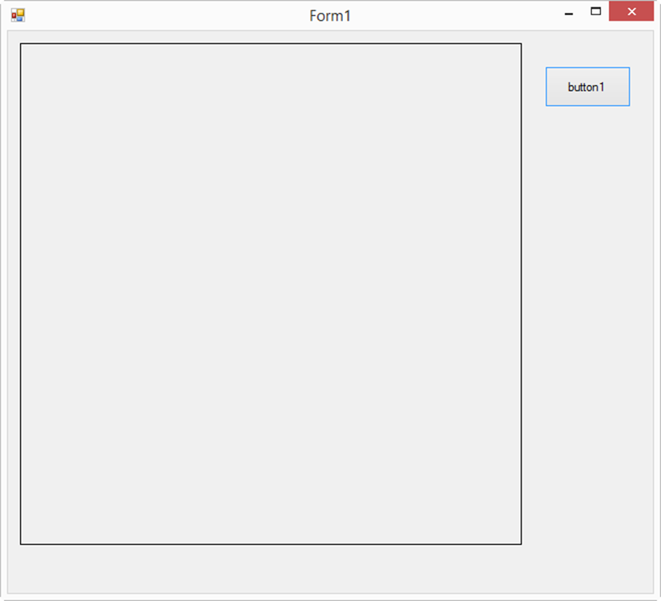
Screen Bounding Rectangle
The Screen bounding rectangle is the size of the PictureBox control
Due to your smaller laptop screens, we set the size to be 501 x 501
Remember Screen Y coordinates are inverted as (0,0) is in the top left
(0, 0)
(0, 500)
(500, 500)

Slide 9
Allegro Graphics Library
An open-source graphics library that runs on Windows, MacOS, and Linux
Source code compatible on all platforms – no changes to run on Windows vs. Linux
Includes several .h headers and .LIBs (static link libraries)
Added to Visual Studio solutions using Microsoft’s NuGet package manager
Installs all necessary binaries
Updates Solution & Project settings, including link paths
Adds additional property pages to VS shell to configure Allegro

Slide 10
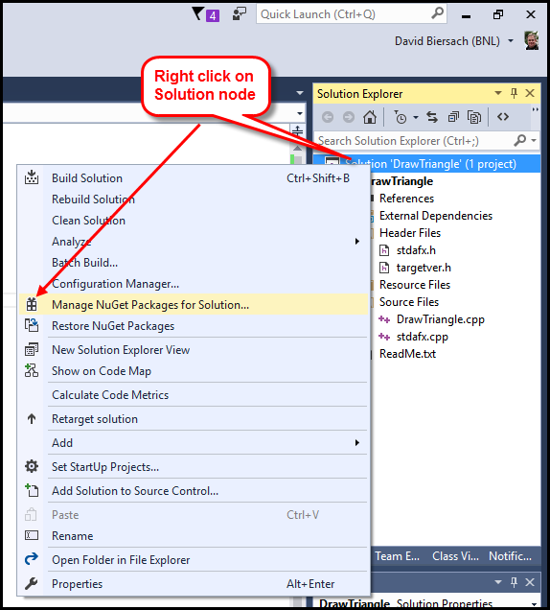
Allegro Graphics Library

Slide 11
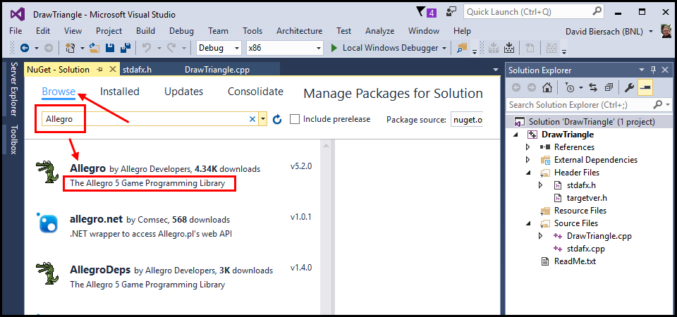
Allegro Graphics Library

Slide 12
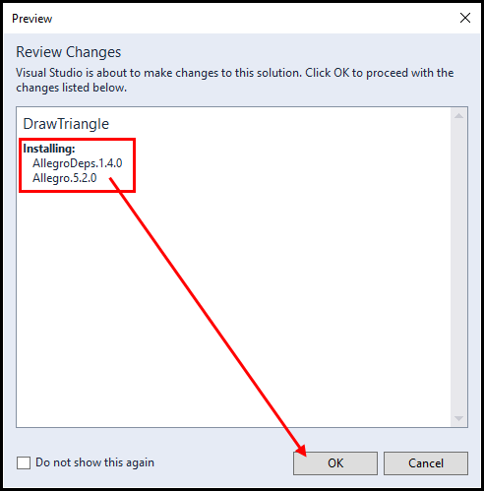
Allegro Graphics Library

Slide 13
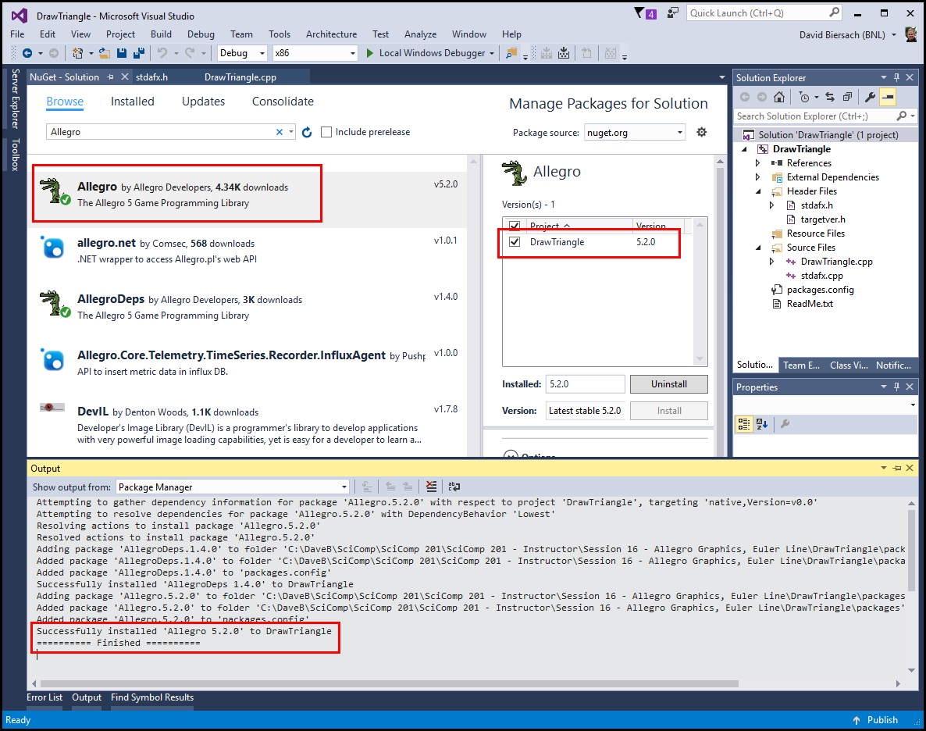
Allegro Graphics Library

Slide 14
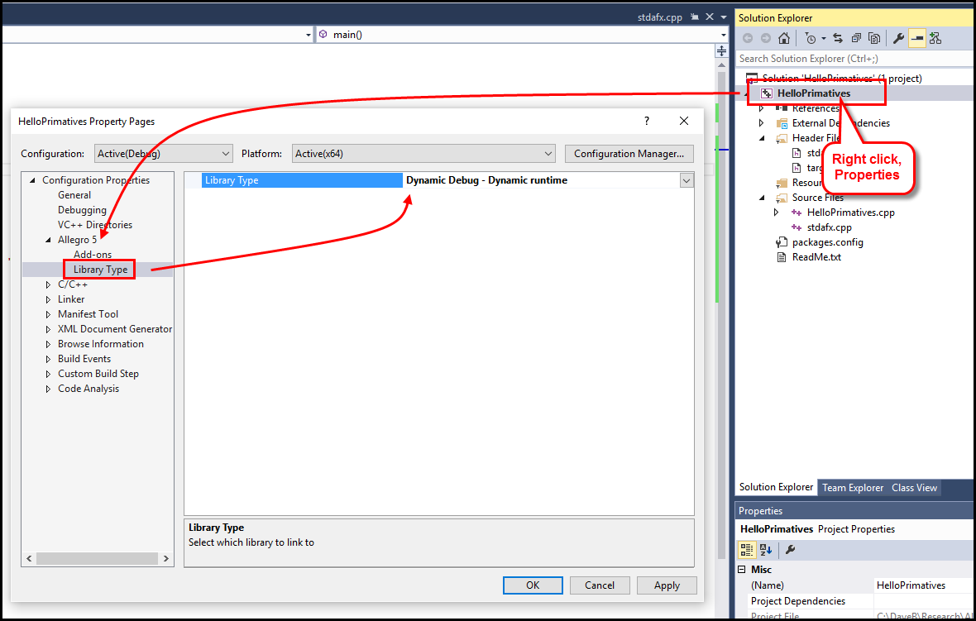
Allegro Graphics Library

Slide 15
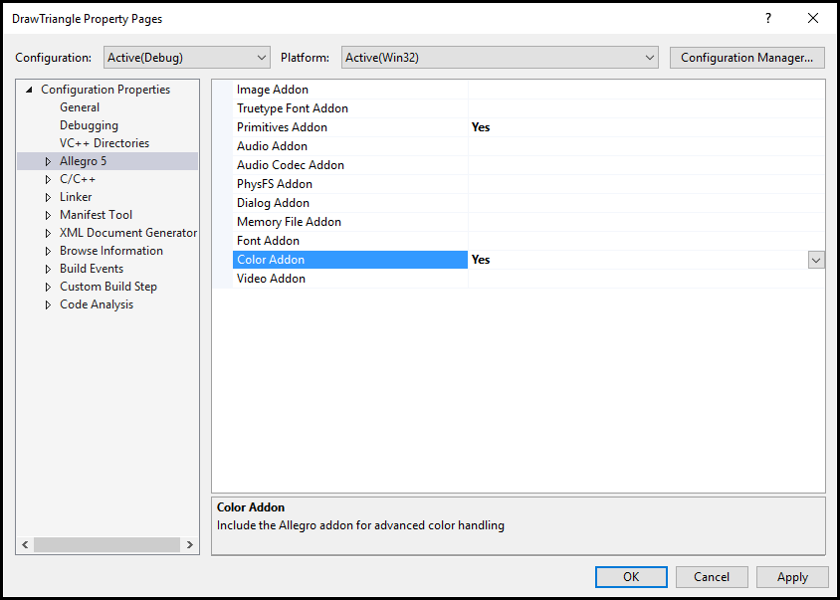
Allegro Graphics Library

Slide 16
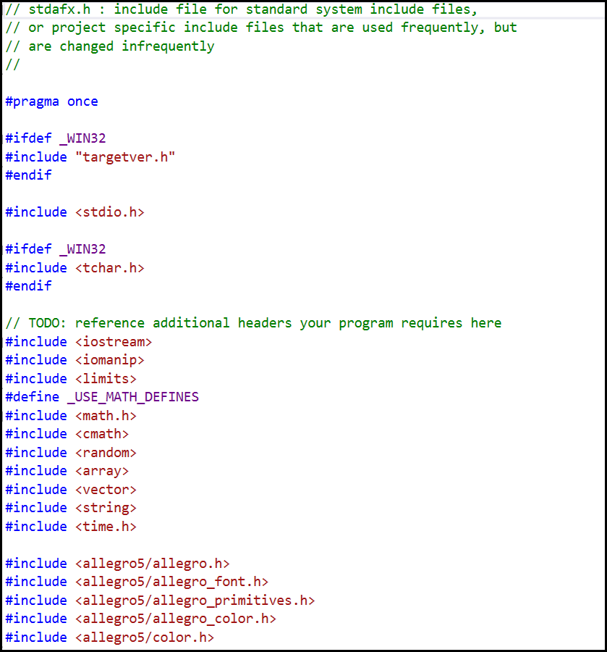
Allegro Graphics Library

Slide 17
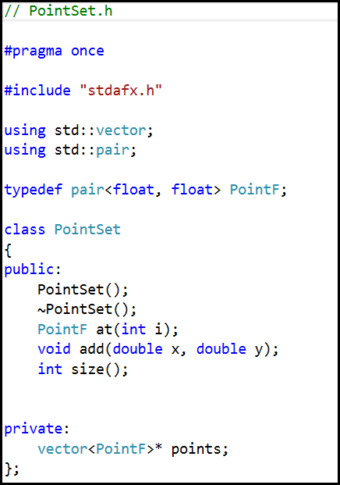
The PointSet Class

Slide 18
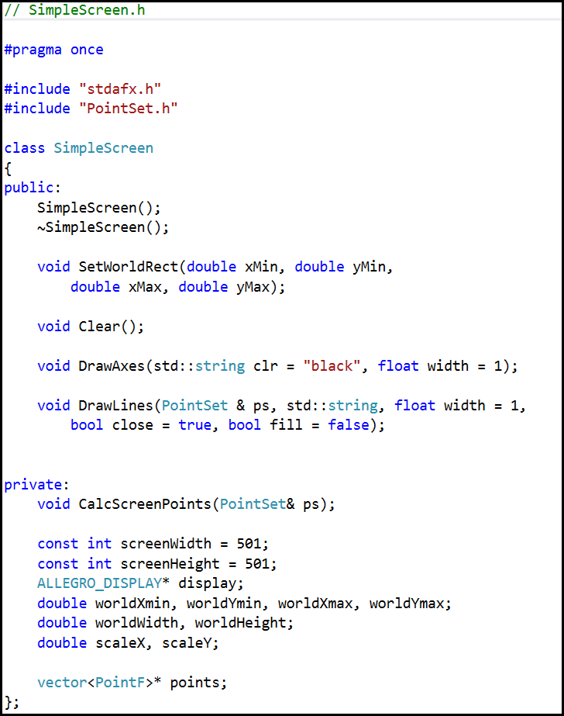
The SimpleScreen Class

Slide 19
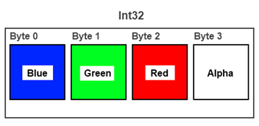

Argb Color Encoding

Slide 20
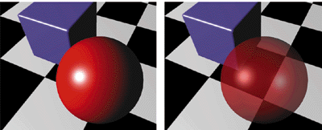
Alpha Blending = Opacity
Alpha = 0 means fully transparent (see through)
Alpha = 255 means fully opaque
We will be using Alpha = 255 in our code

Slide 21
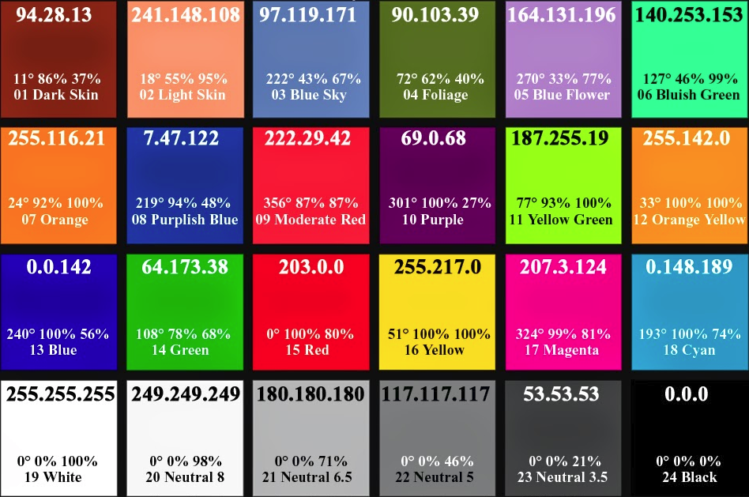
Various Colors in RGB Values

Slide 22
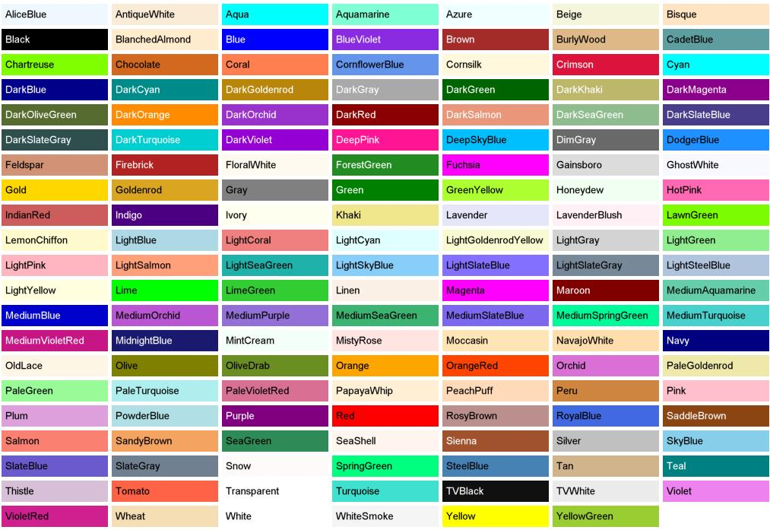
Predefined Color “Names”

Slide 23
Lab 1 – Draw Triangle
Draw a 3-4-5 right triangle in the first quadrant
Paint the entire triangle RED including the interior
Ensure you set the correct world rectangle dimensions

Slide 24
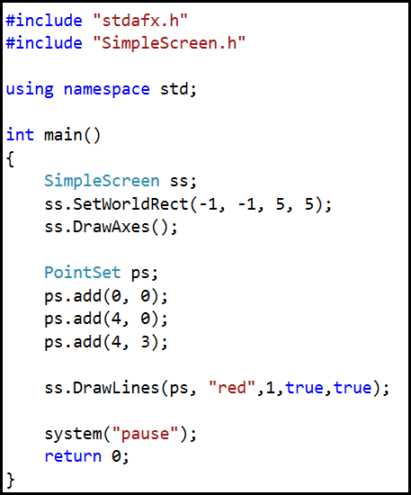
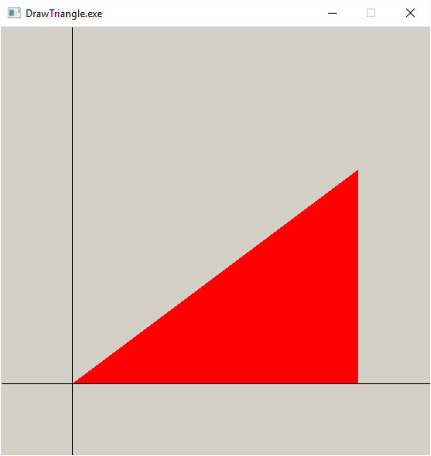
Lab 1 – Draw Triangle

Slide 25
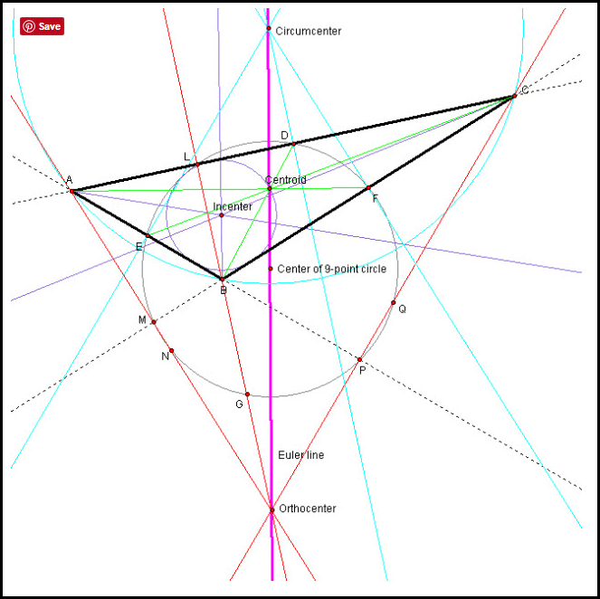
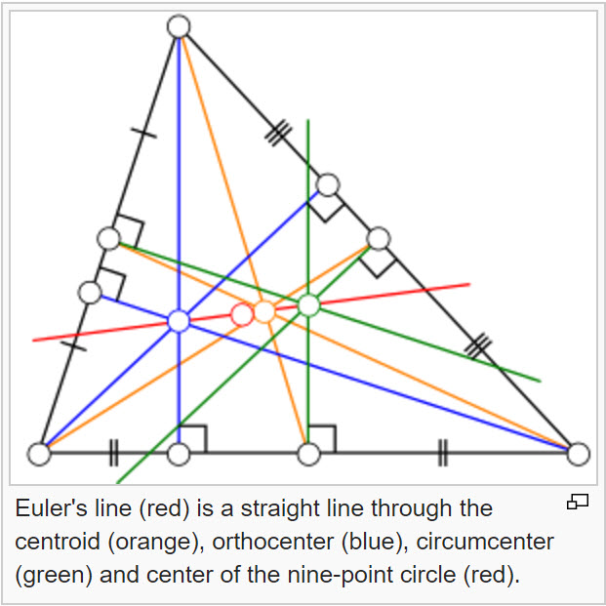
Lab 2 - Euler Line

Slide 26
Now you know…
How to install Allegro as part of NuGet
Select a World rectangle to frame the view
How to create and populate elements of a PointSet
Call the major methods of class SimpleScreen

